Slide 1
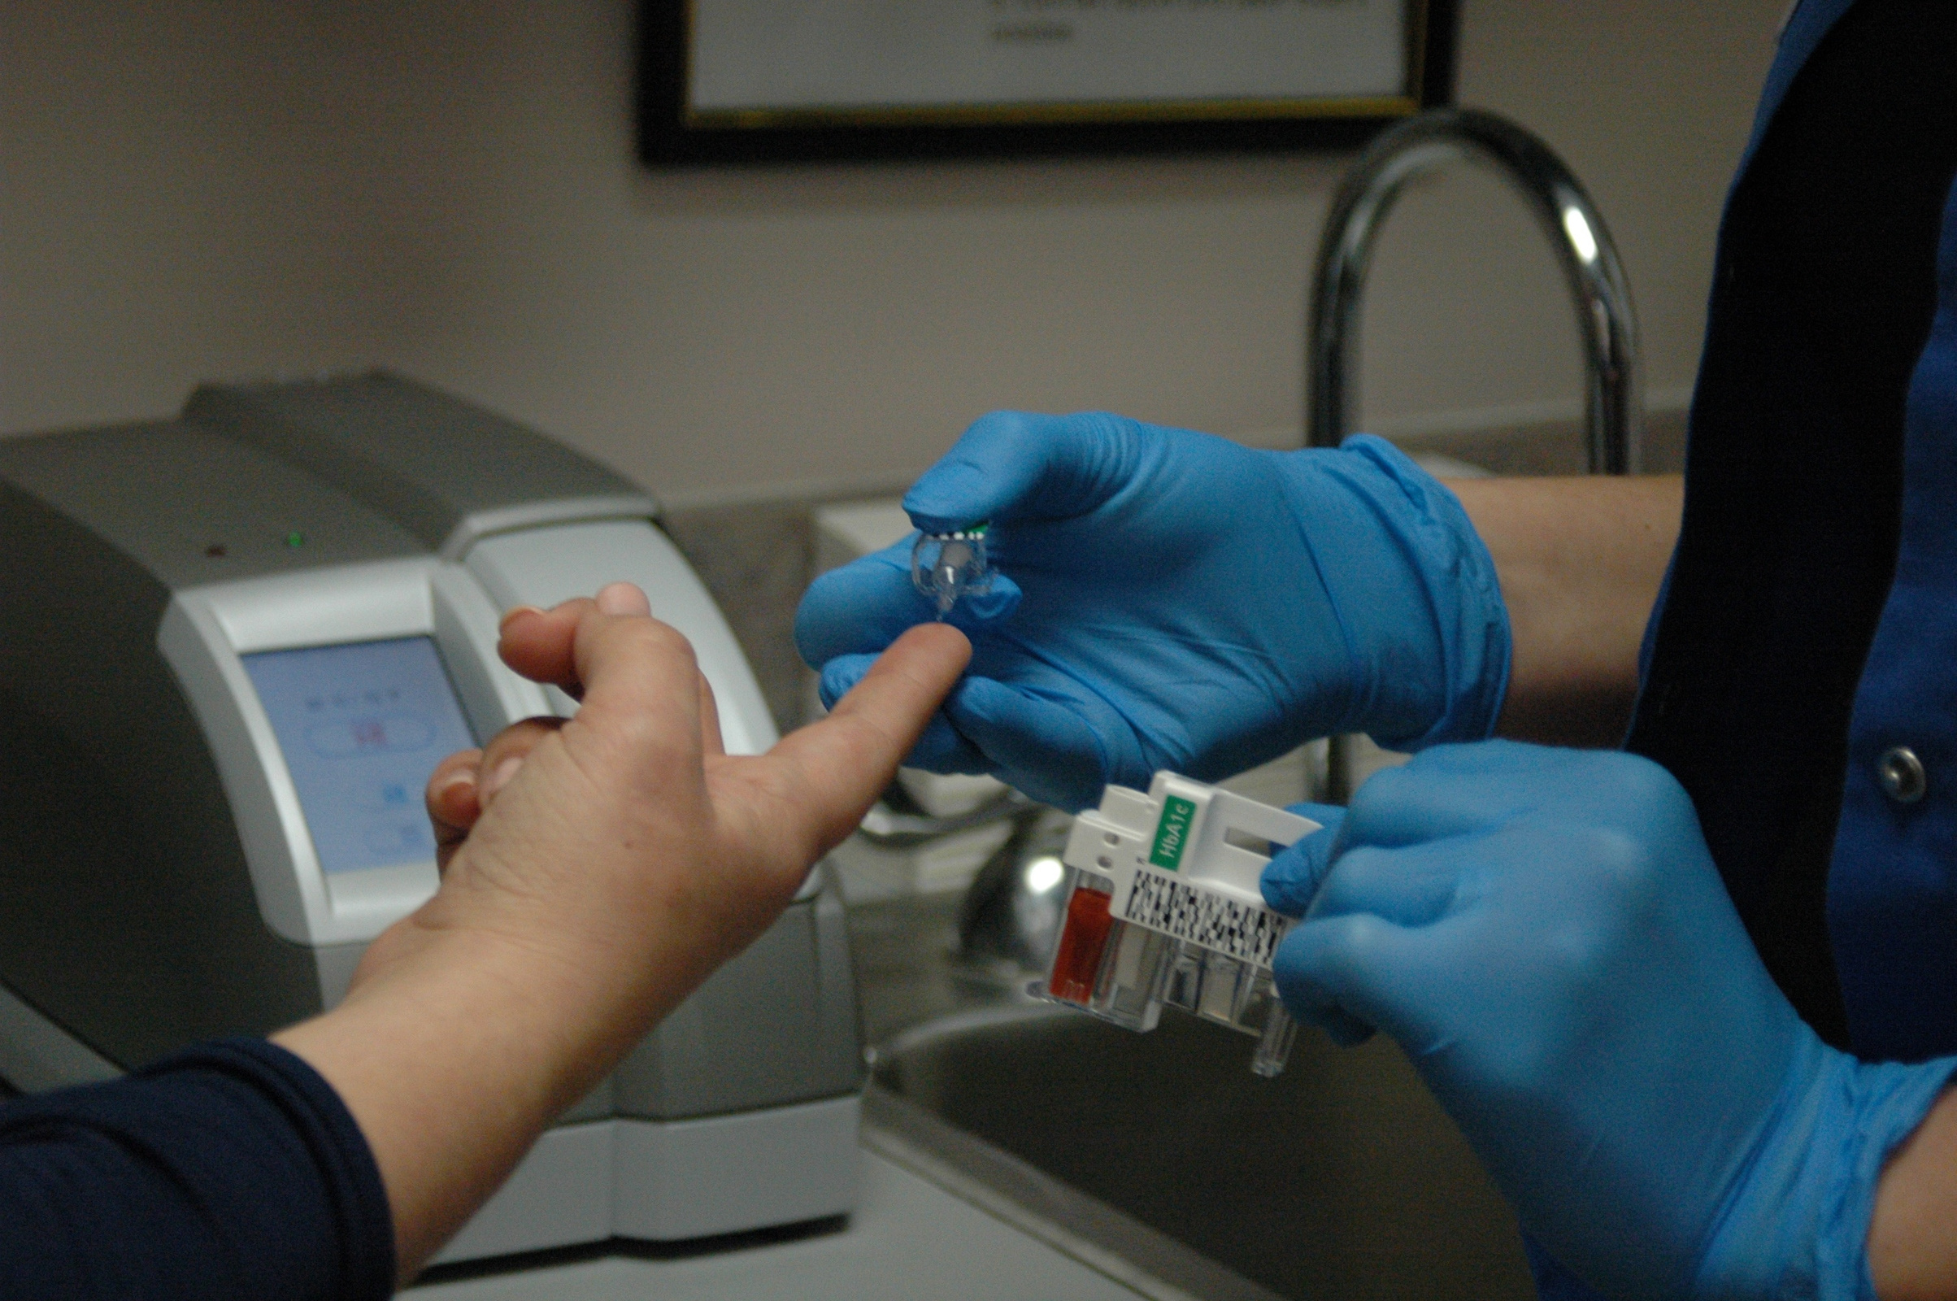

Predicting Diabetes (Classification Project)
Using Machine Learning Algorithms
Group No: 4 | Bhavans Vivekananda Degree College
B.VAMSHI | SRIVANI | SRAVAN KUMAR | NITHIN CHANDRA

Slide 2
ABSTRACT
The project focuses on developing a model that accurately predicts diabetes in a person, leading to early prevention and care.
The study explores machine learning algorithms like Logistic Regression, Decision Tree, Random Forest, K-Nearest Neighbors, Support Vector Machines, and Boosting to predict diabetes.
OBJECTIVE
To find the suitable machine learning model to predict diabetes in a person for giving proper medication and early prevention.

Slide 3

CONTENTS
•Introduction
•Literature Review
•Data Preprocessing
•Exploratory Data Analysis
•Machine Learning Algorithms
•Summary
•Appendix

Slide 4

Introduction
•Diabetes, a growing health crisis, demands early detection for effective management.
•Traditional diagnosis methods are often time-consuming and resource-intensive.
•Machine learning offers a promising solution by analyzing patient data to predict diabetes risk.
This project aims to leverage machine learning algorithms to develop a predictive model to assist healthcare professionals

Slide 5


Slide 6

Literature Review-1
12th International Conference on Computing Communication and
Networking Technologies (ICCCNT). IEEE, 2021.
Md.Mehedi Hassan et al. – Utilized Unsupervised and supervised approaches which yielded 99.57% and 99.03% accuracy for random forest respectively.
Literature Review-2
"Diabetes Detection Based on Machine Learning and Deep Learning Approaches" - Published by Multimedia Tools and Applications in August 2023, this review investigates the impacts of machine learning and deep learning approaches in diabetes identification/classification using non-invasive or anthropometric measurements.

Slide 7
Literature Review-3
"Advances in Artificial Intelligence for Diabetes Prediction: Insights from a Systematic Literature Review" - Published by arXiv in December 2024, this review explores the use of machine learning in predicting diabetes, focusing on datasets, algorithms, training methods, and evaluation metrics.
Literature Review-4
Jobeda Jamal Khanam, Simon Y. Foo -ICT Express, Volume 7, Issue 4, 2021,
Jobeda et al.– Analysed the diabetes data using an Artificial Neural Network with three hidden layers and 400 epochs, providing an accuracy of 88.6%

Slide 8
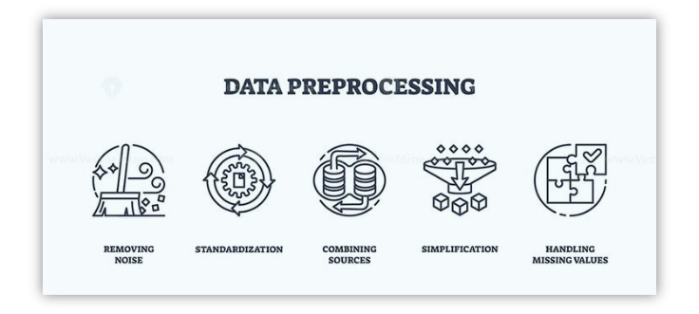

Slide 9
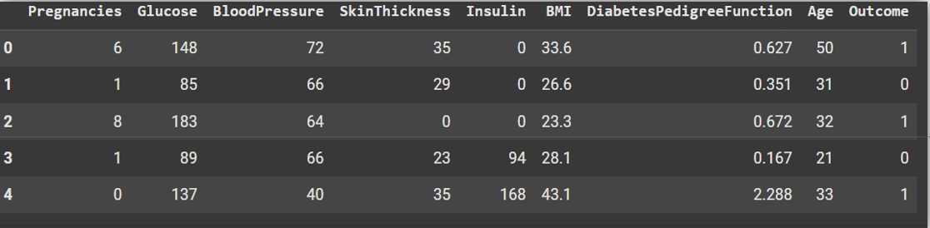
DATA
Dataset: Our Dataset consists of 9 variables and 769 records
source
https://drive.google.com/drive/folders/1vGSRCnhqSxEH53BgLqhh32F1qNKqfOim?usp=drive_link

Slide 10
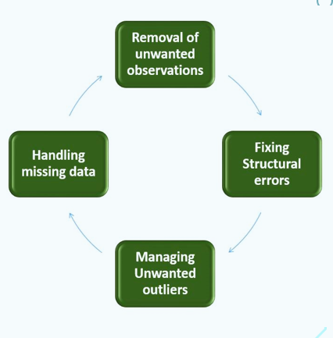
DATA CLEANING
Data cleaning, also known as data cleansing, data scrubbing, data wrangling, or data munging, is the process of identifying and correcting inaccurate, incomplete, or irrelevant data in a dataset
•Checked for missing values and unique values.
•Only for EDA:
•Encoded the BMI variable: Enabled “Overweight”
as 1 and “Normal Weight” as 0
•Age has been converted into two categories:
“Less than 60 years” and “Greater than 60 years”.

Slide 11
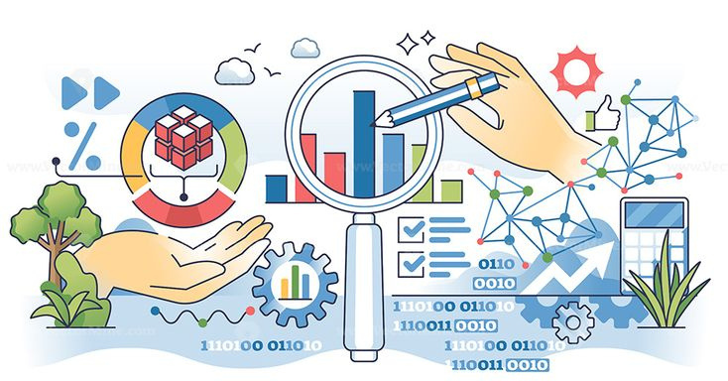
EXPLORATORY DATA ANALYSIS

Slide 12
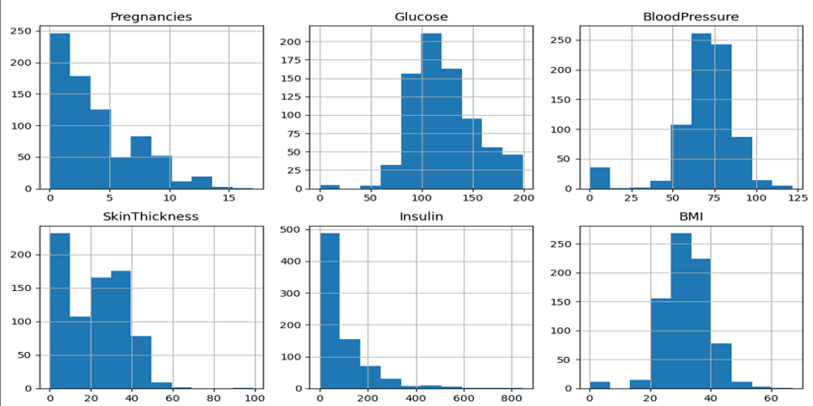
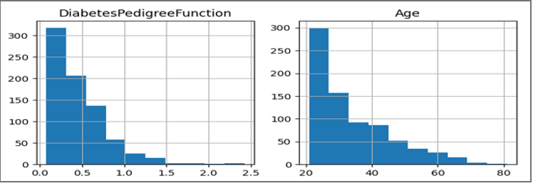
HISTOGRAM
a histogram is a graphical
representation of the distribution of data.

Slide 13
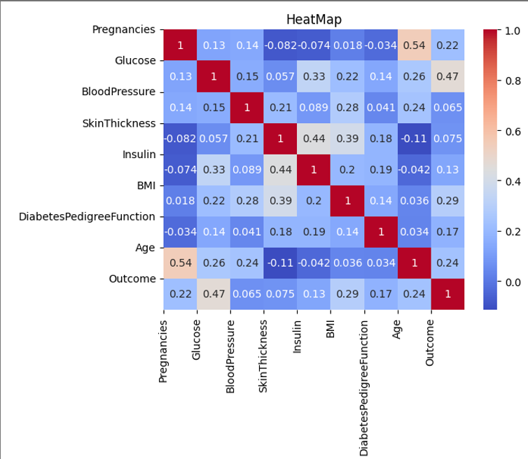
HEAT MAP
all variables are
moderately correlated.

Slide 14
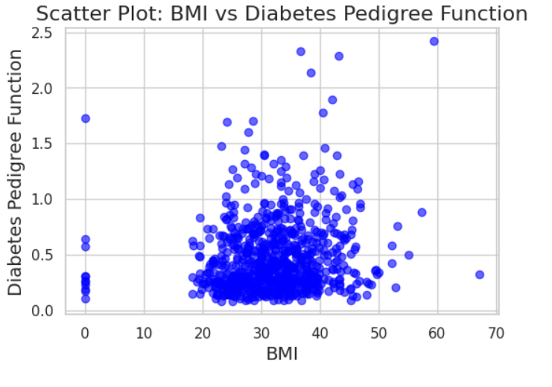
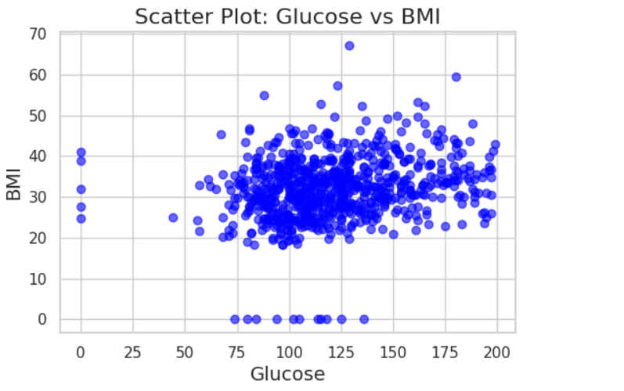
SCATTER PLOT

Slide 15
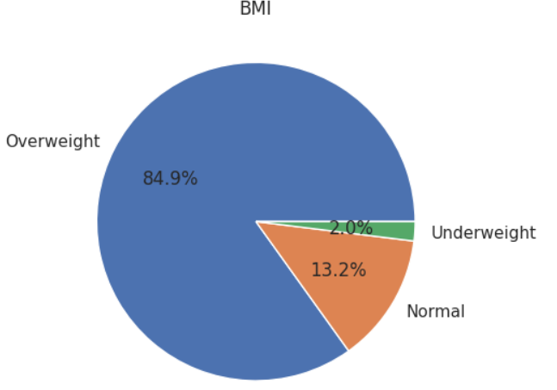
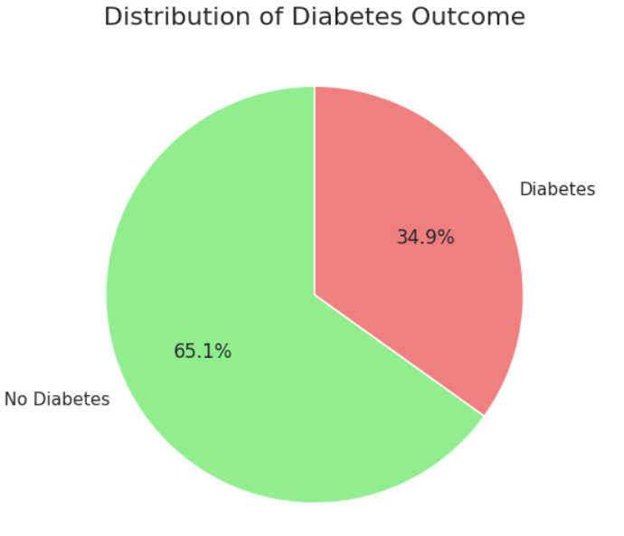
PIE CHART

Slide 16
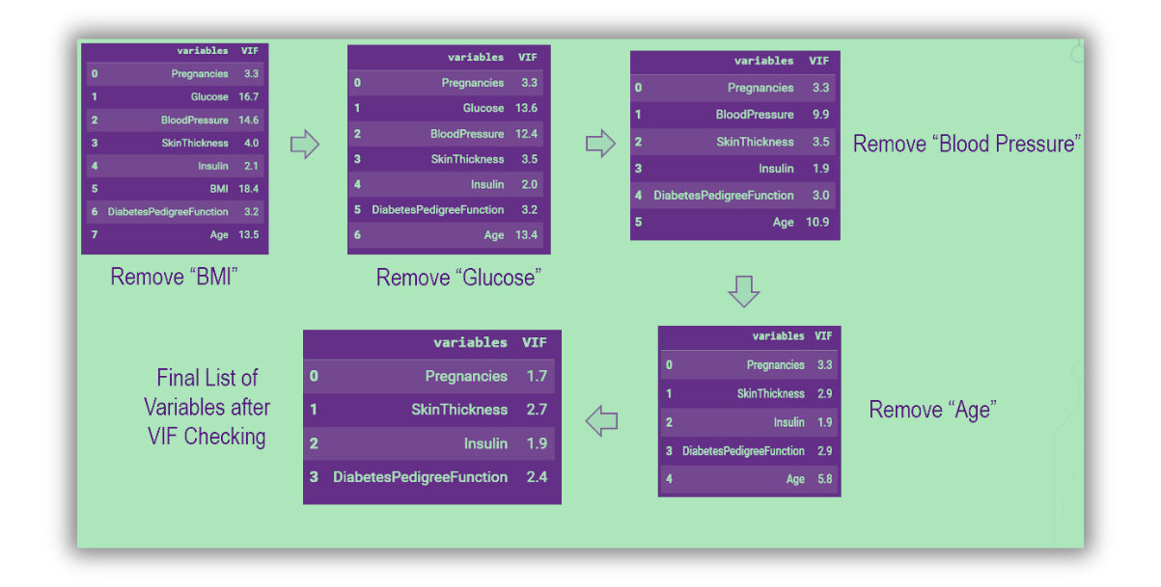
MULTICOLLINEARITY CHECK
(remove blood pressure)
(remove age)

Slide 17

MACHINE LEARNING ALGORITHMS
•Logistic Regression
•K Nearest Neighbour
•Support Vector Machine
•Decision Tree
•Boosting(XG Boosting, Adaptive Boosting)
•Random Forest

Slide 18
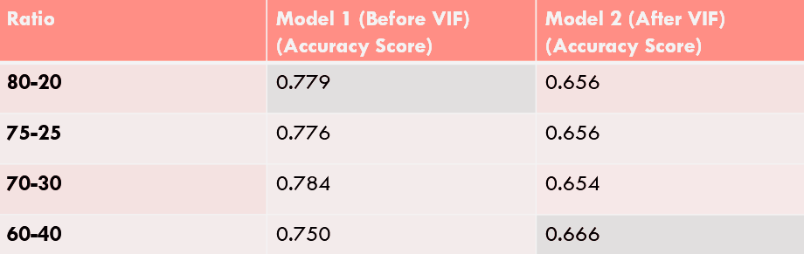
Logistic Regression
Logistic Regression in machine learning is a statistical method used for binary classification tasks, where the goal is to predict one of two possible outcomes(yes or no; 1 or 0; True or false).

Slide 19
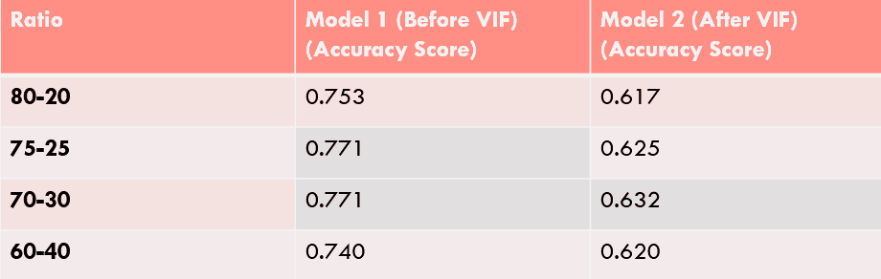
K-Nearest Neighbour
K-Nearest Neighbors is a supervised learning algorithm which makes predictions based on the similarity between a new data point and the existing data points in the training dataset

Slide 20
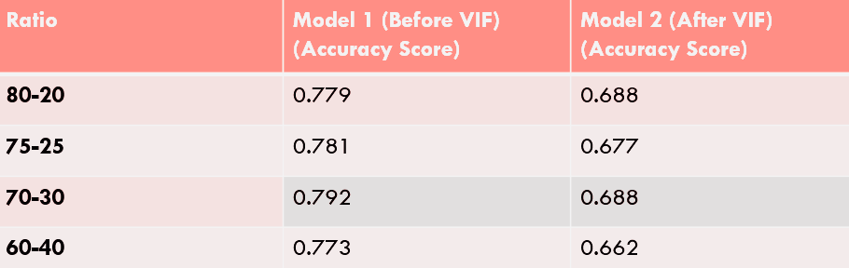
Support Vector Machine
Support Vector Machine is a supervised classification algorithm that finds the optimal decision boundary (hyperplane) that maximizes the margin between different classes.
There are two types of SVM’s - Linear SVM; Non-Linear SVM

Slide 21
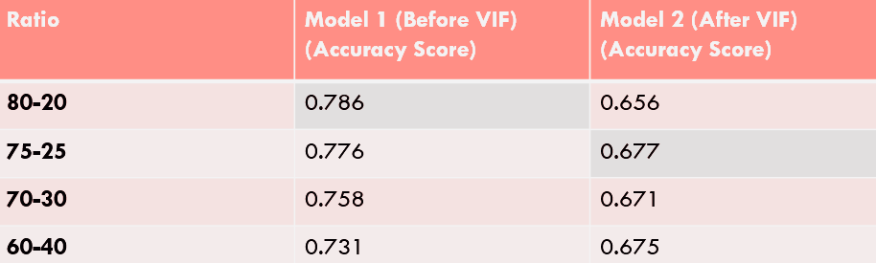
Decision Tree
A Decision Tree is a supervised machine learning algorithm that models decisions and their possible consequences as a tree-like structure, where each node represents a decision based on a feature and each branch represents the outcome of that decision

Slide 22
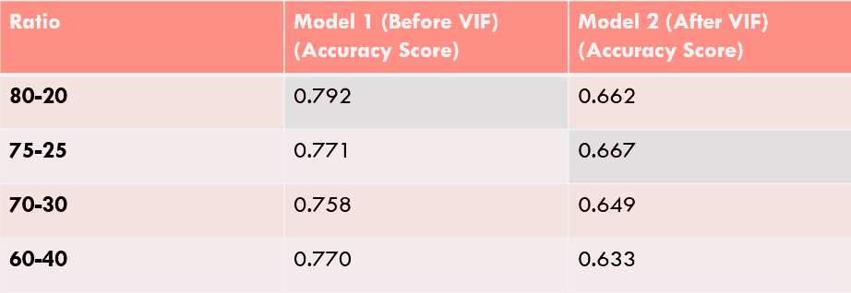
Boosting (XG Boost)
XG Boost (Extreme Gradient Boosting) is an advanced, efficient version of gradient boosting that builds a strong model by combining many weak decision trees and optimizes performance through techniques like regularization, parallelization, and handling missing values

Slide 23
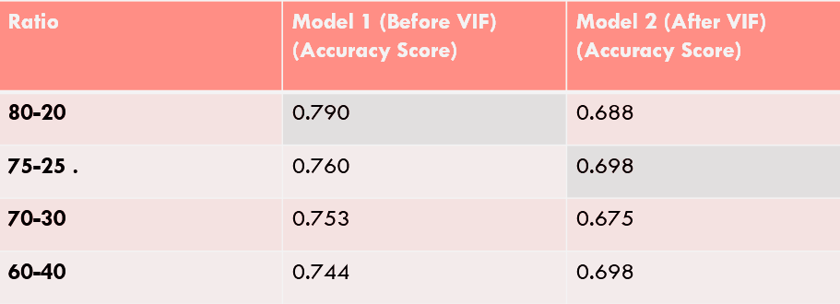
Boosting (Adaptive Boosting)
Adaptive Boosting is a machine learning algorithm that improves the accuracy of weak learners by focusing on the data points that are hardest to classify. It works by sequentially training weak models, adjusting the weights of misclassified data points, and combining the predictions of all models into a stronger classifier.

Slide 24
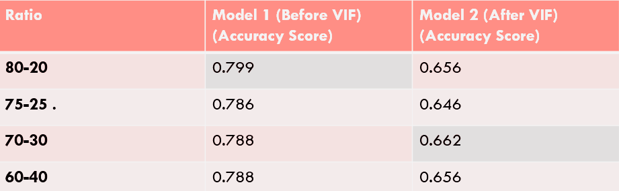
Random Forest
Random Forest is an ensemble learning algorithm that combines multiple decision trees to create a more accurate and stable model. It reduces overfitting by using random samples of data and features to build each tree and by averaging (or voting) across all trees for final predictions

Slide 25
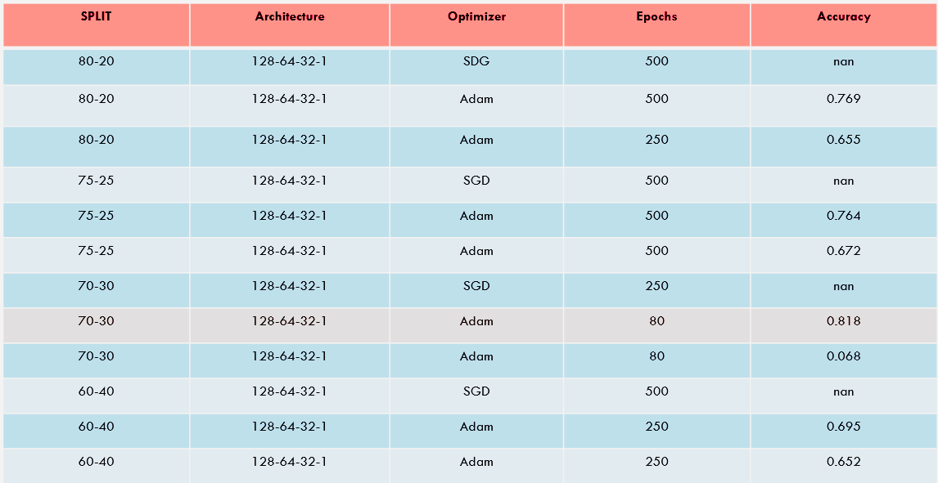
Artificial Neural Network

Slide 26
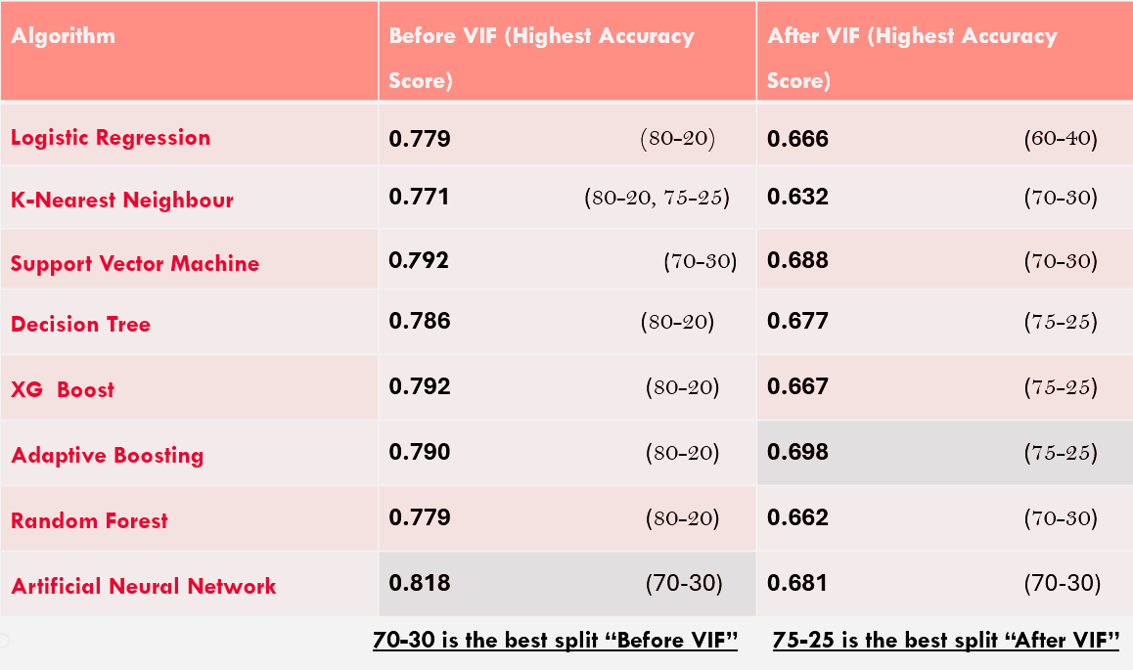
FINDING THE BEST SPLIT

Slide 27
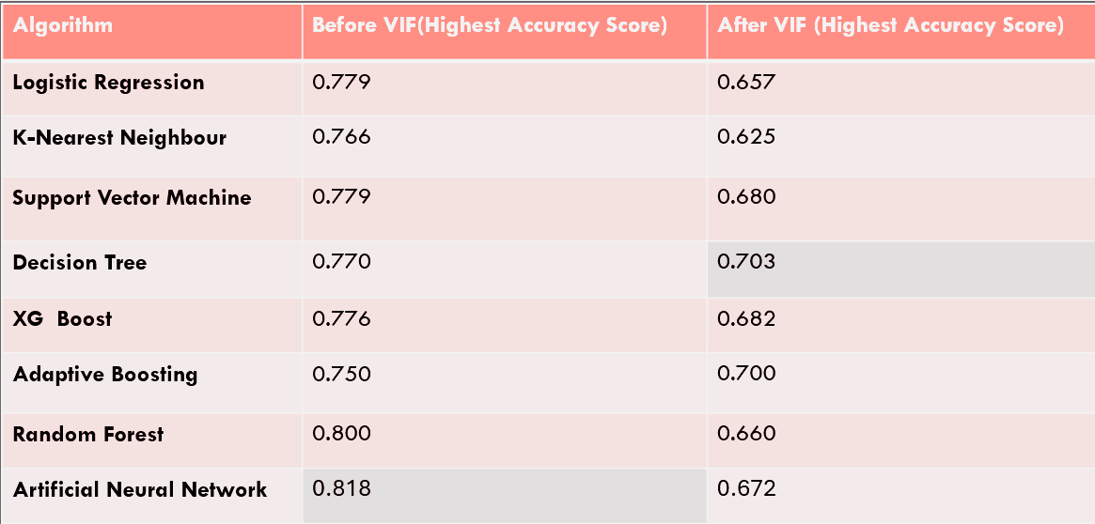
FINDING THE BEST ALGORITHM
Artificial Neural Network Algorithm has the highest accuracy

Slide 28
Conclusion
In this diabetes prediction ML project, insights from data preprocessing, model selection, evaluation metrics, and deployment are essential for building an effective tool for diabetes prediction. By applying machine learning techniques, the model can aid healthcare professionals in early detection, which can lead to better management and treatment of diabetes. Future work can enhance the model's capabilities through more advanced techniques, real-time data integration, and careful consideration of ethical concerns.

Slide 29

FUTURE SCOPE
The future of diabetes prediction research is very promising, with numerous opportunities to leverage cutting-edge technologies such as artificial intelligence, big data, and genomics. The integration of personalized healthcare, real-time monitoring, and ethical AI models will revolutionize diabetes management and prevention. Ultimately, the goal is to improve early detection, reduce complications, and help individuals live healthier lives through more accurate and individualized predictions and interventions.

Slide 30
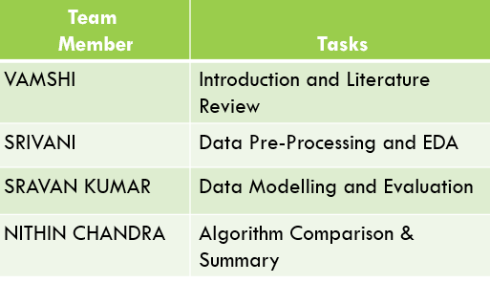
Work Distribution

Slide 31
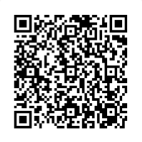
Colab Notebook
THANKYOU
Done By
Sravan kumar(107222546009)
Vamshi(107222546010)
Srivani (107222546011)
Nithin chandra (107222546012)
https://colab.research.google.com/drive/1TGwZXRQxxOZuHYt5VuDCR1FRAjR0LHvR?usp=sharing

Slide 32
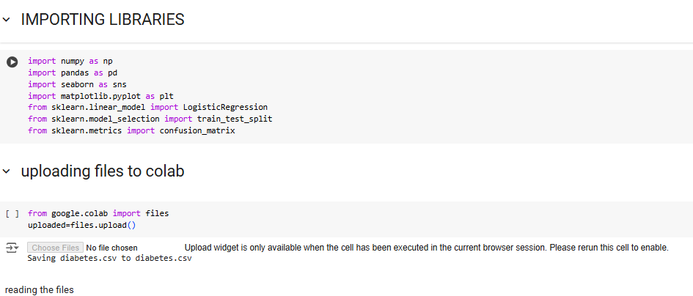
Appendix

Slide 33
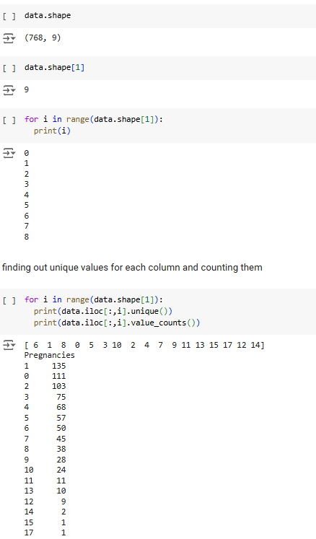
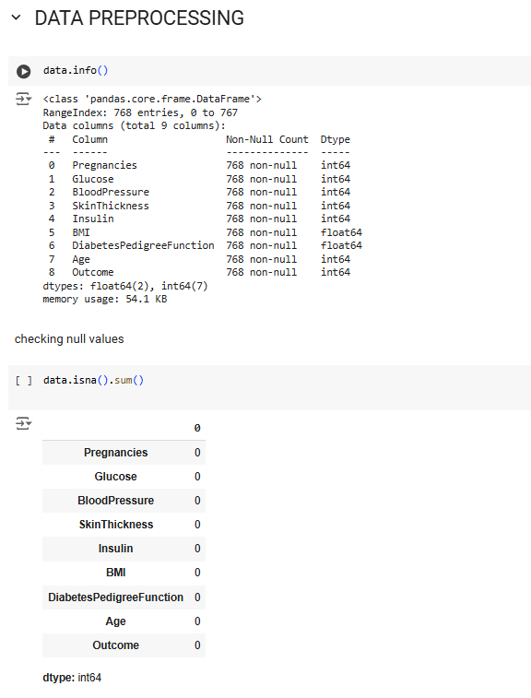
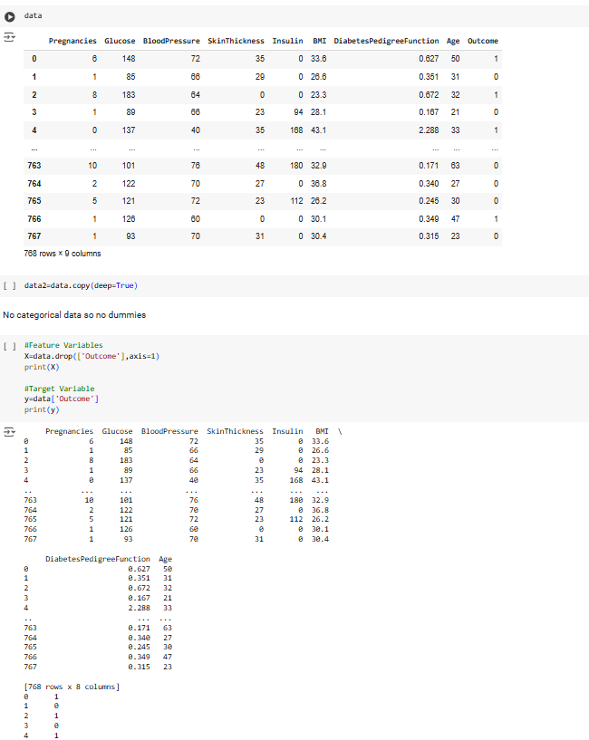

Slide 34
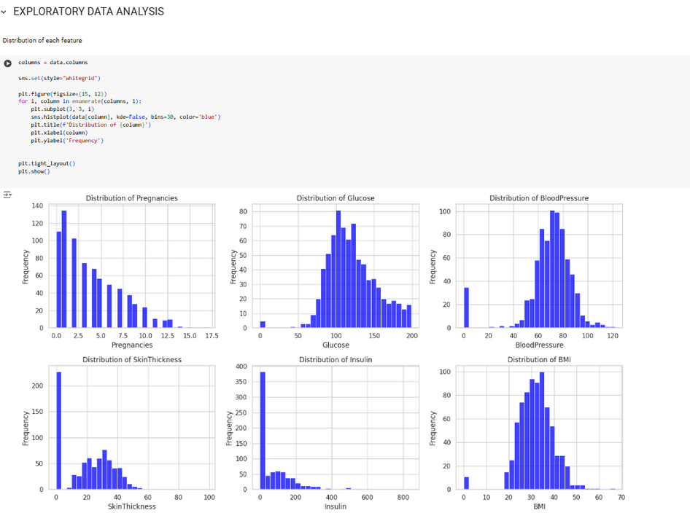
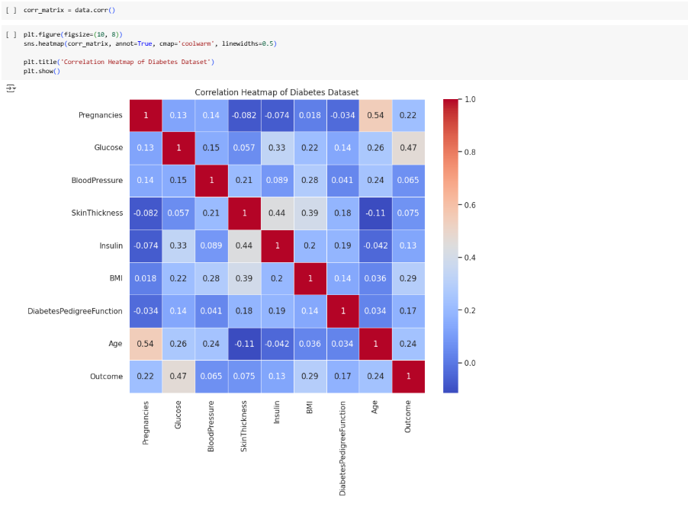

Slide 35
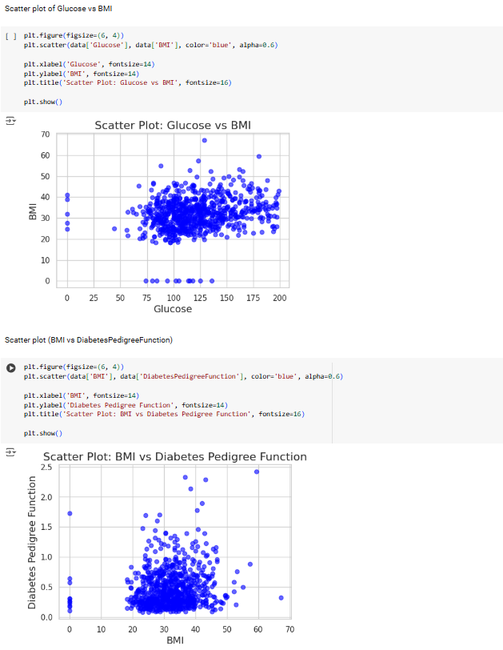

Slide 36
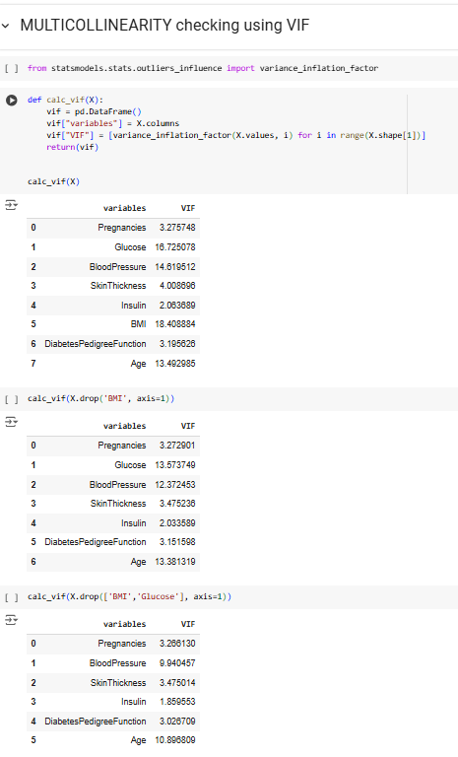
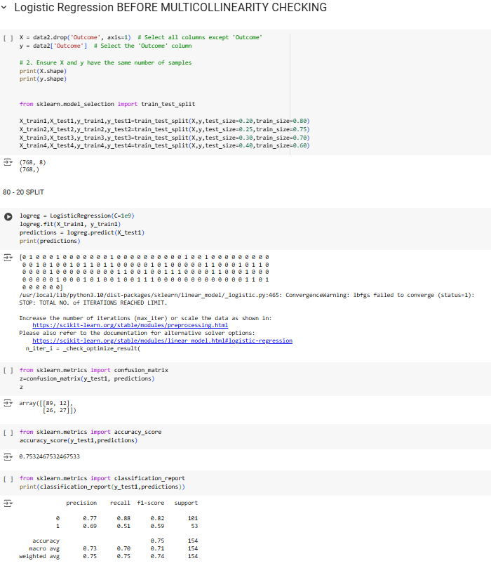

Slide 37
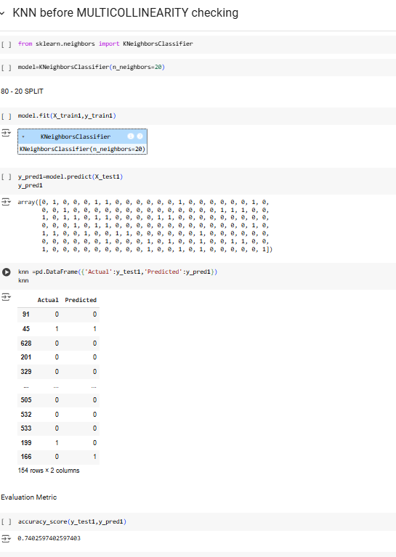
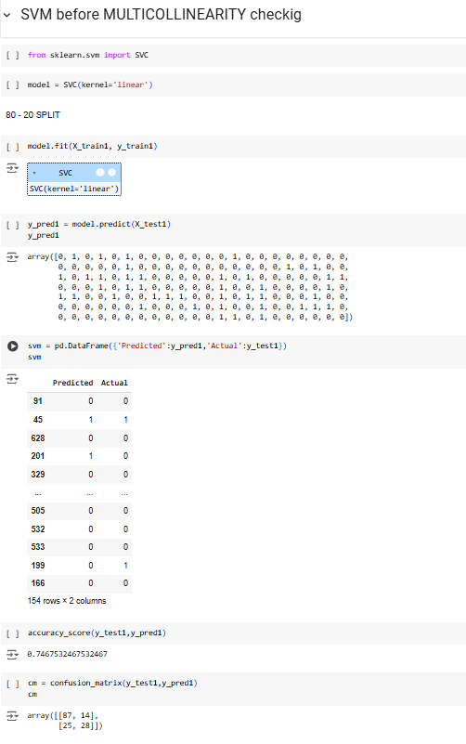

Slide 38
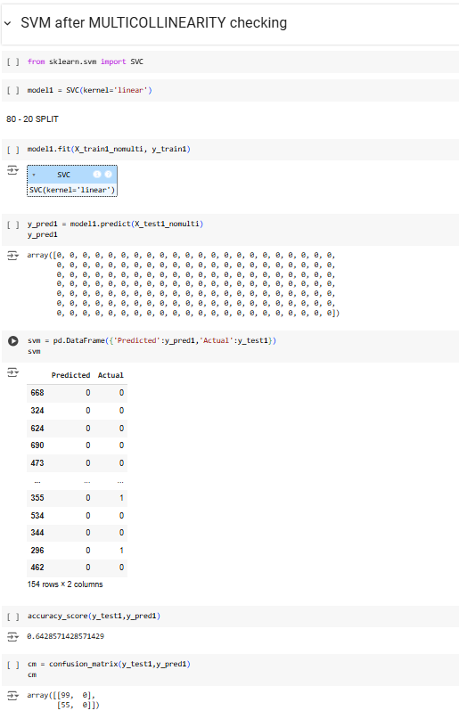
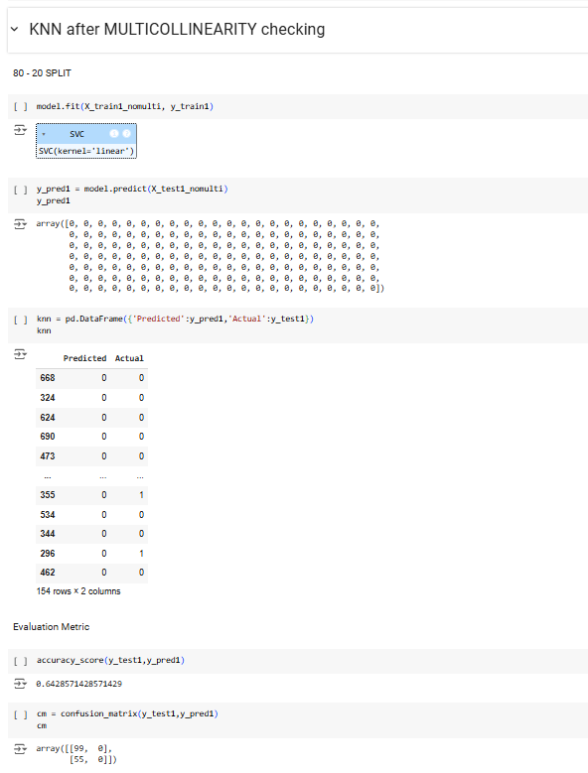

Slide 39
Thank you

